Slide 1
Massively Multilingual Sentence Embeddings
for Zero-Shot Cross-Lingual Transfer and Beyond
https://arxiv.org/pdf/1812.10464.pdf
전 창 욱

Slide 2
Abstract
We introduce an architecture to learn joint multilingual sentence representations for 93 languages, belonging to more than 30 different language families and written in 28 different scripts.
Our system uses a single BiLSTM encoder with a shared BPE vocabulary for all languages, which is coupled with an auxiliary decoder and trained on publicly available parallel corpora.
This enables us to learn a classifier on top of the resulting sentence embeddings using English annotated data only, and transfer it to any of the 93 languages without any modification.
Our approach sets a new state-of-the-art on zero-shot cross-lingual natural language inference for all the 14 languages in the XNLI dataset but one.

Slide 3
Dataset
To train the language model, the authors created a comprehensive dataset that consists of sentences and their translation in additional languages. The dataset is based on multiple
sources:
Professional translations — the European Union dataset (Europarl) for 21 languages, the United Nations dataset in 6 languages and Quran translations in 42 languages
User-generated translations — OpenSubtitles with movie subtitles in 57 languages, and Tatoeba, a community-based dataset with English sentences translated to hundreds of languages.
The final dataset includes 223 million parallel sentences in 93 languages from 34 families (e.g. Germanic and Semitic) and 28 scripts (Latin to Hebrew).

Slide 4
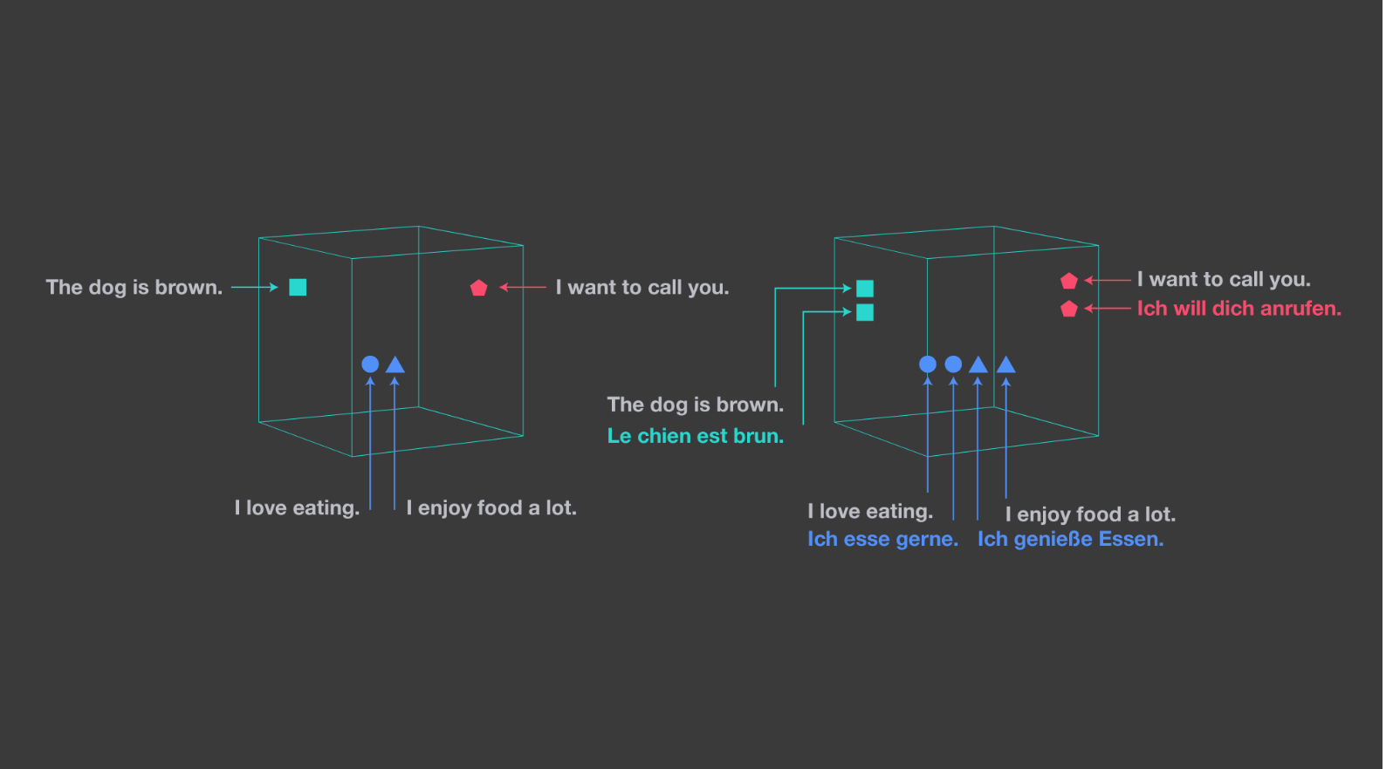
Universal, language-agnostic sentence embeddings
The image on the left shows a monolingual embedding space. The one on the right illustrates LASER’s approach, which embeds all languages in a single, shared space.

Slide 5
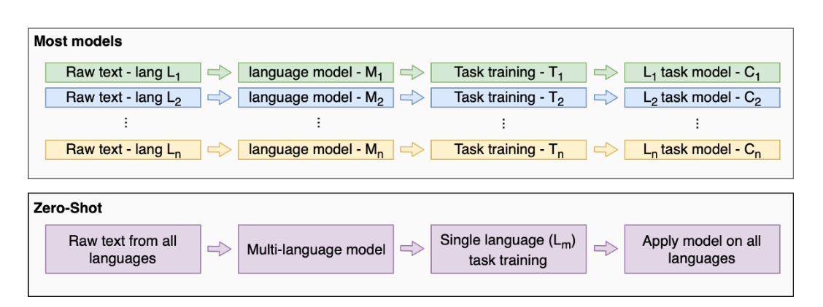
Zero-Shot, are simplicity (one model for all) and efficiency especially due to faster training.
Zero-Shot approach vs other models

Slide 6
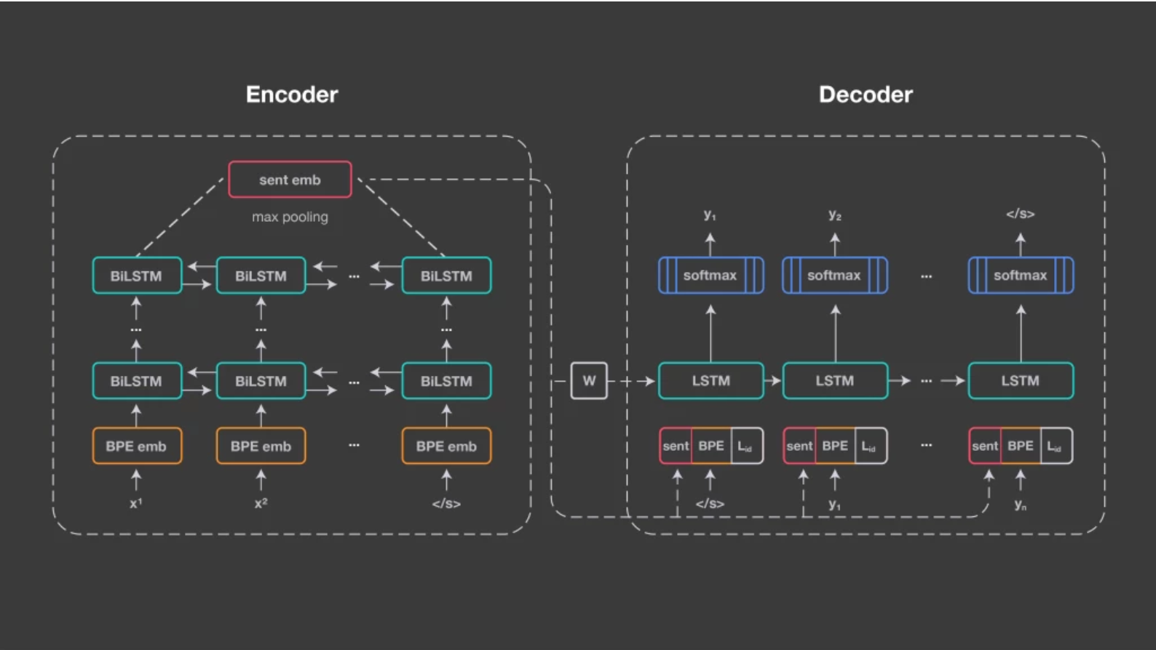
encoder/decoder approach
encoder is a five-layer bidirectional LSTM 512-dimension
we do not use an attention mechanism but instead have a 1,024-dimension fixed-size vector to represent the input sentence.
max-pooling over the last states of the BiLSTM
decoder has always one layer of dimension 2048.
The input embedding size is set to 320,
while the language ID embedding has 32 dimensions.
This figure illustrates the architecture of our approach.

Slide 7
We use a joint byte-pair encoding (BPE) vocabulary with 50,000 operations, trained on the concatenation of all training corpora
To avoid quadratic cost as the number of learned languages increases, the model is trained only with two target languages (English and Spanish) and not all-vs-all.

Slide 8
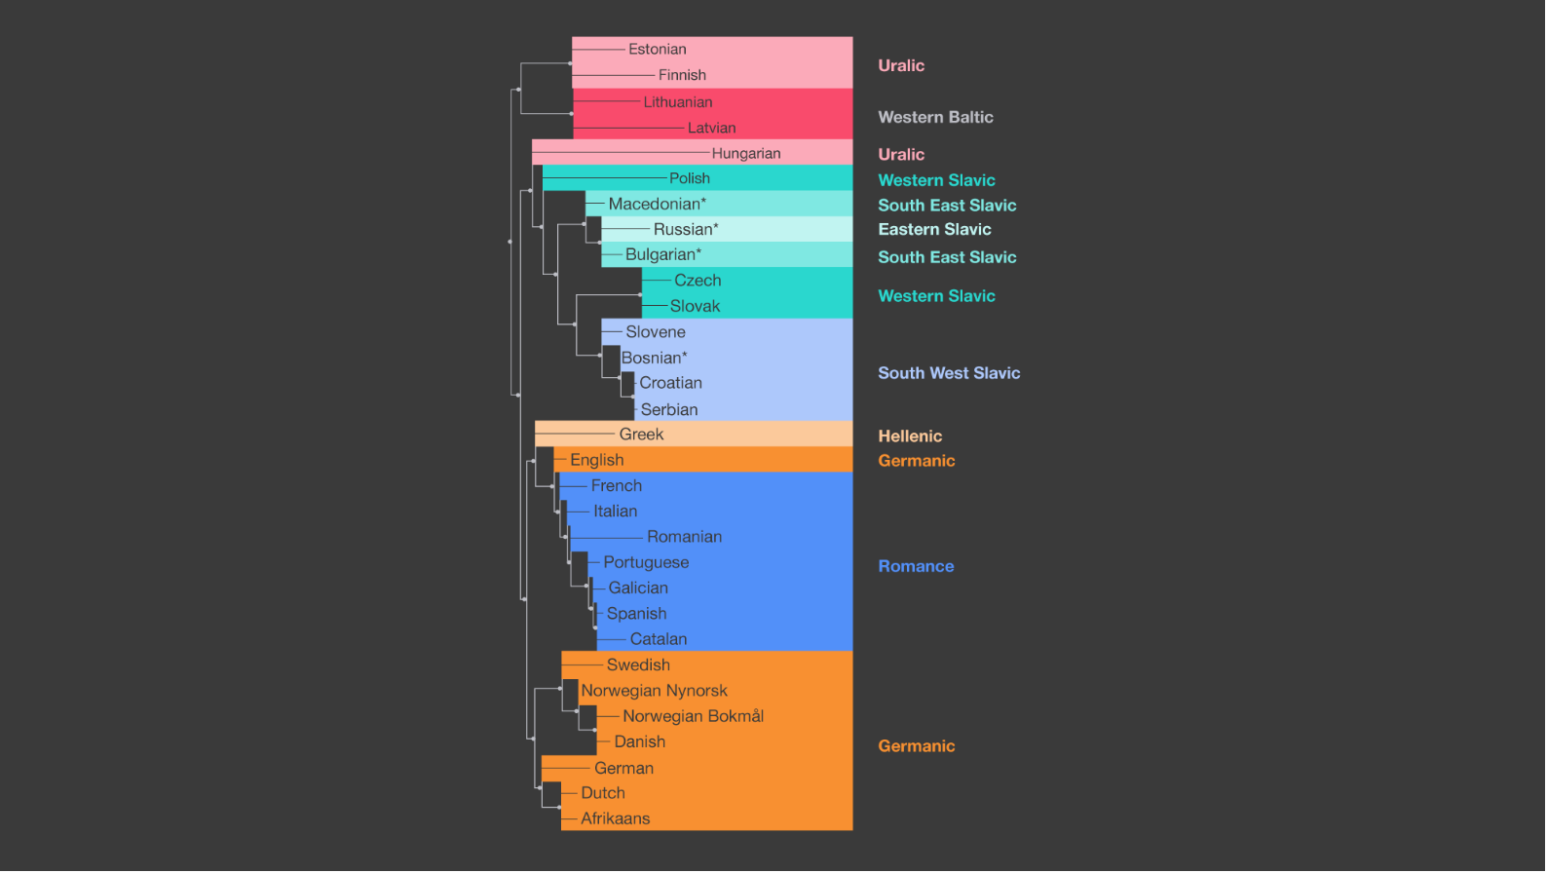
This was possible by using a shared BPE vocabulary trained on the concatenation of all languages. An analysis and clustering of the symmetrized Kullback-Leiber distances between the distributions on the BPE vocabulary for each language showed an almost perfect correlation with the linguistically defined language families.
This graphic illustrates the relationships automatically discovered by LASER between various languages. They correspond very well to the language families manually defined by linguists.

Slide 9
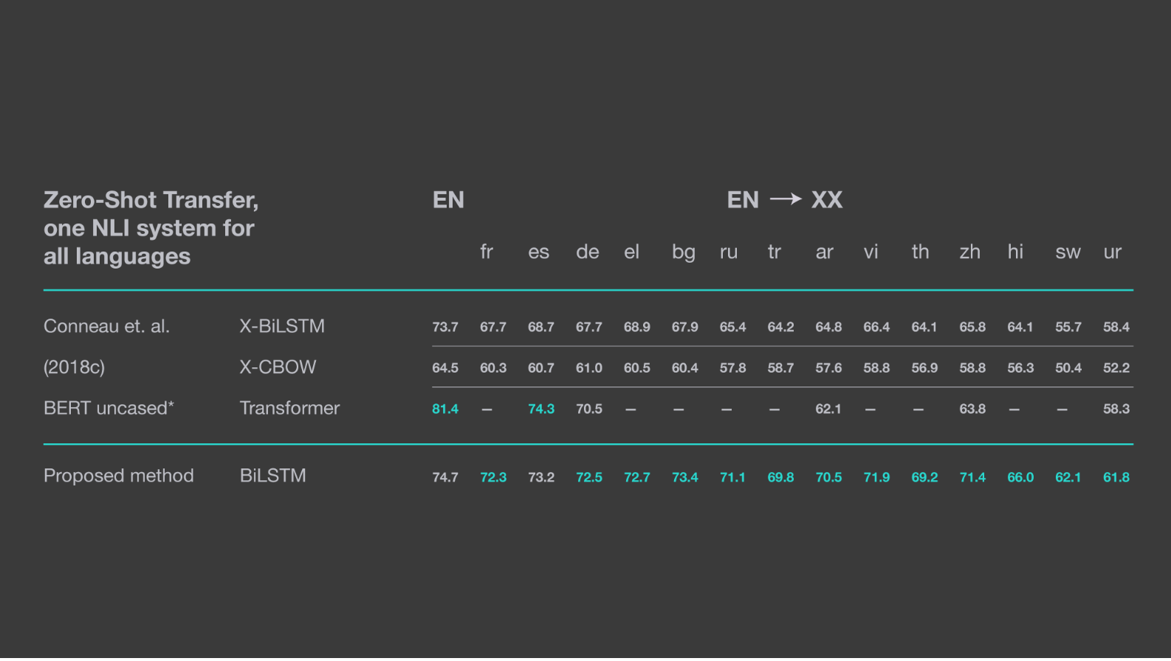
This table shows LASER’s zero-shot transfer performance on the XNLI corpus (Conneau et al., “Evaluating Cross-lingual Sentence Representations,” EMNLP ’18). Results for BERT are extracted from its GitHub README. (Note: These results were obtained with the PyTorch 1.0 implementation, so the numbers are slightly different than in the paper, which used PyTorch 0.4.)

Slide 10
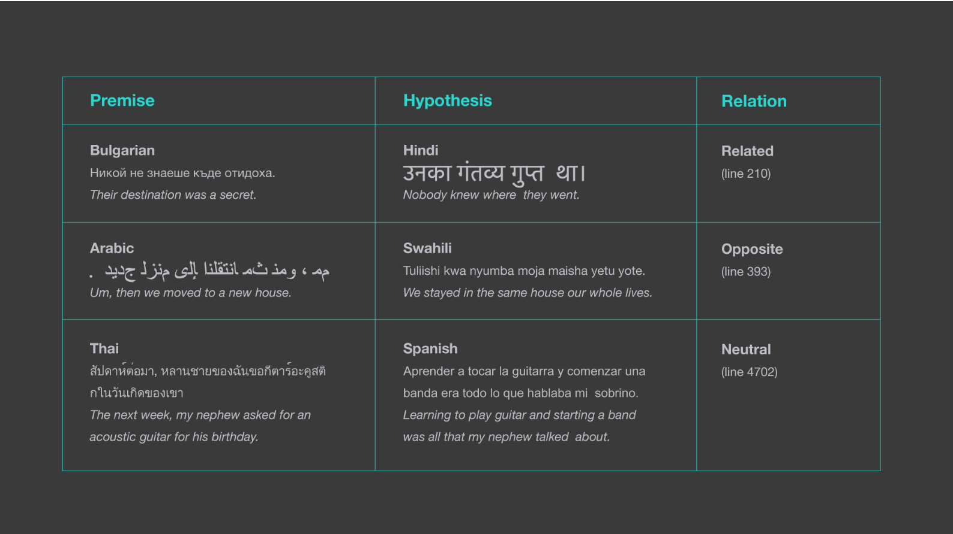
Zero-shot, cross-lingual natural language inference
This table shows how LASER was able to determine the relationship between sentences from the XNLI corpus in different languages. Previous approaches only considered premise and hypothesis in the same language.

Slide 11
Per-task training
The trained encoder can be used for solving other NLP tasks:
Natural Language Inference (NLI) — Deciding if the relationship between two sentences, a premise (p) and a hypothesis (h), is an entailment, contradiction or neutral. By combining the sentences in the following way (p, h, p·h, |p−h|) and using that as an input to train a small neural network with two layers, the model learns to predict the relationship.
Topic classification — Classifying short texts (such as news articles) to a given list of topics, by embedding a text with the encoder and training a single layer network (with 10 units and a softmax unit afterward).
Similar sentence identification — An even simpler usage is to find the translation of given a sentence from a dataset of sentences in another language. This task only requires to encode all sentences and calculate the distance between them with cosine similarity or a more sophisticated metric (as proposed in the paper).

Slide 12
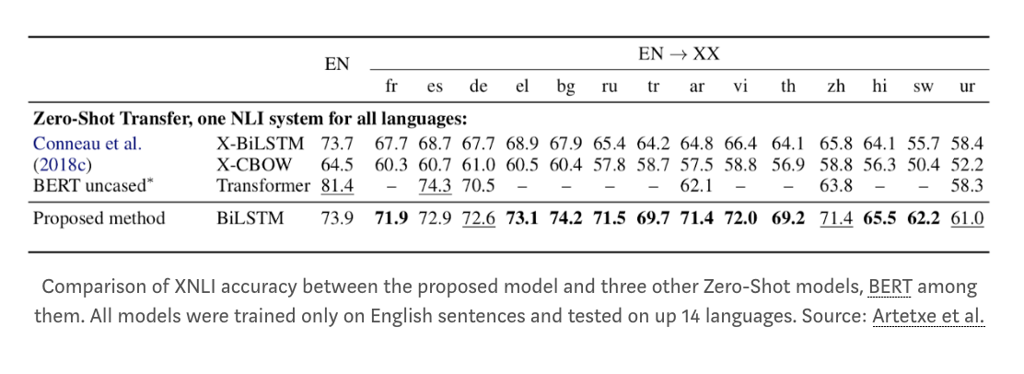
Results

Slide 13
Compute & Implementation
The model was implemented in Pytorch using fairseq for the encoder and the decoder.
The language model was trained with 16 NVIDIA V100 GPUs for about 5 days.

Slide 14
Conclusion
The Multilingual Sentence Embeddings presents a novel technique for creating language models, which is faster, simpler and scalable.
It can easily be fitted to new languages and new tasks while achieving strong results across many languages.
It can even work with “unknown” languages that aren’t part of the language model.
BERT architecture, e.g. using its Transformer instead of the BiLSTM module

Slide 15
https://code.fb.com/ai-research/laser-multilingual-sentence-embeddings/
https://www.groundai.com/project/massively-multilingual-sentence-embeddings-for-zero-shot-cross-lingual-transfer-and-beyond/
https://towardsdatascience.com/explained-multilingual-sentence-embeddings-for-zero-shot-transfer-5f2cdf7d4fab
https://arxiv.org/pdf/1812.10464.pdf

